Slide 1
Linear Regression and classification
Subject: Introduction to Artificial Intelligence and its Applications Code: 19EAI232
Registration Number: 12201032 Name: Saran
Registration Number: 122010325012 Name: Jaswanth Sunkara
Semester: IV - Session April 2022

Slide 2
What is Linear Regression ?
Linear Regression is a machine learning algorithm based on supervised learning. It performs a regression task.
Regression models a target prediction value based on independent variables.
It is mostly used for finding out the relationship between variables and forecasting.
Different regression models differ based on – the kind of relationship between dependent and independent variables they are considering, and the number of independent variables getting used.

Slide 3
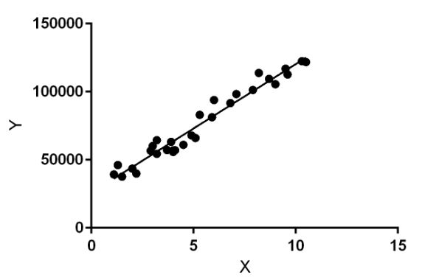
What is Linear Regression ?
Linear regression performs the task to predict a dependent variable value (y) based on a given independent variable (x). So, this regression technique finds out a linear relationship between x (input) and y(output). Hence, the name is Linear Regression. In the figure above, X (input) is the work experience and Y (output) is the salary of a person. The regression line is the best fit line for our model.

Slide 4
Applications
Linear regression is widely used in biological, behavioral and social sciences to describe possible relationships between variables. It ranks as one of the most important tools used in these disciplines.
Implementing linear regression for small data is very straightforward we can use many existing Java classes, such as Simple Regression from Apache Commons. However, these classes and packages can not handle a huge amount of data due to the limited memory and CPU resources in a single server.

Slide 5
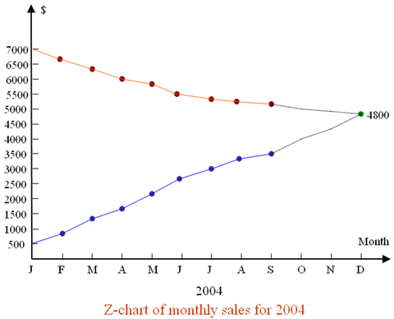
Applications
If a company, wants to know if the funds that they have invested in marketing a particular brand has given them substantial return on investment, they can use linear regression.

Slide 6
Applications
Linear Regression isn’t always about business, its also important in sports. For instance, you might wonder if the number of games won by a basketball team is related to the average number of points the team scores per game.
With linear regression, you can model the relationship of these variables. A good model can be used to predict how many games teams will win.
Linear regression can also be used to analyze the marketing effectiveness, pricing and promotions on sales of a product.
The trend can be examined using linear regression, they can be closely watched while promoting or setting the pricing or even checking the effectiveness of the sales of a product

Slide 7
Applications
Linear regressions can be used in business to evaluate trends and make estimates or forecasts.
For example, if a company's sales have increased steadily every month for the past few years, by conducting a linear analysis on the sales data with monthly sales, the company could forecast sales in future months
Supposing two campaigns are run on TV and Radio in parallel, a linear regression can capture the isolated as well as the combined impact of running this ads together.
Predicting the Salary of a person based on years of experience- Therefore, Experience becomes the independent while Salary turns into the dependent variable.

Slide 8
Predicting crop yields based on the amount of rainfall-Yield is a dependent variable while the measure of precipitation is an independent variable.

Slide 9
References
https://www.quora.com/What-are-the-best-applications-of-linear-regression
https://www.analyticssteps.com/blogs/7-types-regression-technique-you-should-know-machine-learning
https://www.analyticssteps.com/blogs/simple-linear-regression-applications-limitations-examples
https://www.analyticsvidhya.com/blog/2021/05/all-you-need-to-know-about-your-first-machine-learning-model-linear-regression

Slide 10
THANK YOU

